Slide 1
Revision Record
Don’t Print This Page
COURSE CODE
PRODUCT
PRODUCT VERSION
COURSE VERSION
Domain
Huawei IPCC and Platform Introduction
ICDV300R005C45
eSpace CC ISV V100R001C01LINH04
DEVELOPER / MODIFIER
DATE
APPROVER
NEW / UPDATE
VIJAYASARATHY P. R.
2011-10-20
NEW
Manish (9986697003)
2012-02-02
UPDATE

Slide 2
Overview of Huawei IP Contact Center System & Architecture

Slide 3

Objectives
Upon completing this course, you will be familiar with:
Overview of HUAWEI IPCC system, architecture and features
The core components of HUAWEI IPCC System
HUAWEI Universal Access Platform (UAP)
HUAWEI Computer Telephony Interface (CTI) Platform
Highlights of HUAWEI IPCC Solution

Slide 4

Target Audience
This course has been designed for the following audience :
Solution Designers
Technical Architects
Contact Center - IT Managers
Implementation Engineers
Technical Support Engineers

Slide 5
Training Pre Requisites
This course has been designed for audience who are familiar with:
Basics of Telecom concepts
Basics of Contact Center
Basics of IP Telephony
Basics of IP Networking

Slide 6

HUAWEI IPCC INTRODUCTION
CORE COMPONENTS OF HUAWEI IPCC
INTRODUCTION TO UAP
INTRODUCTION TO CTI PLATFORM
HUAWEI IPCC HIGHLIGHTS

Slide 7
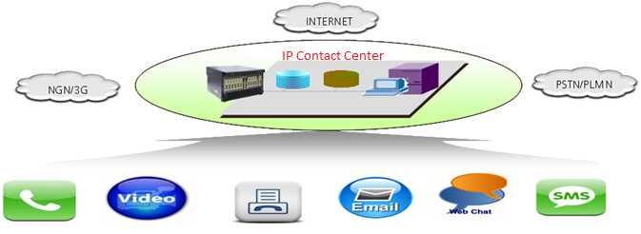
HUAWEI IPCC
HUAWEI Contact Center solution is an All IP integrated solution based on the Public Switched Telephone Network (PSTN), the Public Landline Mobile Network (PLMN) and Next-generation Network (NGN).
HUAWEI’s IPCC accepts voice calls from Time Division Multiplexed (TDM) networks such as the PSTN/PLMN as well as calls from IP networks such as NGN/IP Media Service (IMS).
Customers can also reach the HUAWEI IPCC through various Multimedia channels such as fax, email, video, Web, Short Message Service (SMS).

Slide 8











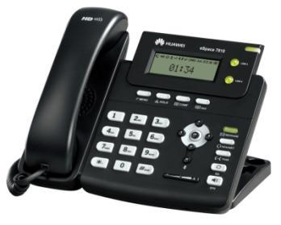
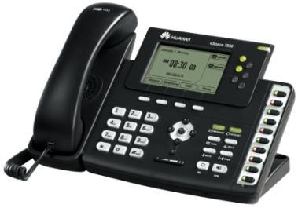
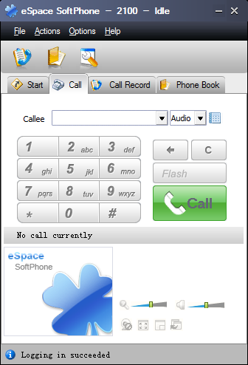
HUAWEI IPCC Portfolio
Applications
Agent server
HPS
iWeb Report
Quality Control
Real time monitor
Middleware
CTI
IVR
ASR / TTS
MailM
WebM
Recording
Reporting
ACD
Small & Medium Enterprise
Large Enterprises
UAP3300
U2990
Gateways
IAD104H
IAD208
IAD132
Terminals
eSpace 7810
eSpace 7850
eSpace SoftPhone
Notes:
This slide talks about the Product portfolio of HUAWEI IPCC
Cloud management: in NIRC resources can be in shared mode

Slide 9

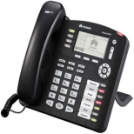




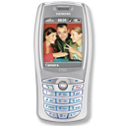
HUAWEI IPCC Architecture
Self service
Agent assisted service
Network management system I2000
Service implementing
layer
Function support
layer
Interactive voice response (IVR)
Core server of the contact center (CCS)
Media adaptation
layer
CTI media server (CTI Server)
Web media server (WebM)
Email media server (MailM)
Media access
layer
SoftACD (UAP)
Multimedia service
platform (MSP)
NGN/3G
PSTN/PLMN
Internet
Voice
SMS
Fax
Email
Web
Video
Notes:
Media Access layer
The media accessing layer provides the access for multiple media such as voice/fax, VoIP, Web and e-mail and provides the lower-layer access function for the IPCC.
Media Adaptation layer
Media adapting layer is responsible for adaptation for various call media. Speech calls, e-mail calls and Web calls are processed to be a unified contact so that various media can communicate with the service supporting layer irrespective of the type of media
Function Support layer
Function support layer submits the function requirements of the calls to the Media access layer through the media adaptation layer, and implements the call control function with the cooperation of the Service Implementing layer.
Service Implementing layer
This layer implements specific service application with the computer network technology and the support of the function support layer, media adaptation layer and media access layer.

Slide 10
HUAWEI IPCC INTRODUCTION
CORE COMPONENTS OF HUAWEI IPCC
INTRODUCTION TO UAP
INTRODUCTION TO CTI PLATFORM
HUAWEI IPCC HIGHLIGHTS

Slide 11
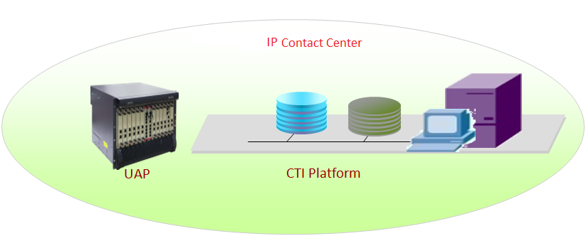
Core Components of HUAWEI IPCC
HUAWEI’s IPCC Center solution’s core components are:
Universal Access Platform (UAP)
CTI Platform
Notes:
UAP and the CTI form the basic components of Huawei IPCC.
They are the mainstay without which Huawei IPCC is not able to function

Slide 12
HUAWEI IPCC INTRODUCTION
CORE COMPONENTS OF HUAWEI IPCC
INTRODUCTION TO UAP
INTRODUCTION TO CTI PLATFORM
HUAWEI IPCC HIGHLIGHTS

Slide 13
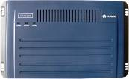
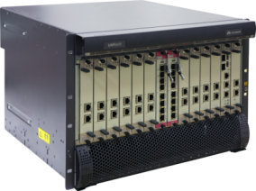
HUAWEI UAP
The UAP is a HUAWEI-developed media resource platform that integrates both narrowband and broadband access.
HUAWEI’s UAP comes in different variants that have been designed to cater to different enterprise market segments.
UAP3300
U2990
20-960 agents
Small & medium Enterprise
10000 Agents
Large Enterprise
Notes:
UAP 3300-Narrow Band
4 Mrs and 4 DTU.
1 DTU =120 voice channels so 4 DTU =480 voice channels. IVR =480 and Agents= 240.
UAP 3300-Broadband
6 MRS
1 MRS supports 120 voice channels.
6 MRS= 120 *6= 720 voice channels.
IVR =720 and Agents =320.
UAP supports maximum of 6 MRS boards.
1DTU =4 trunks
Agent requires san additional channel compared to IVR for recording purpose.

Slide 14
UAP Functions
Access Gateway
PSTN/PLMN Network Connection
NGN Network Connection
Media Resource Platform
Voice Announcement
Voice Recording
Fax Services
Outbound Tone Detection
TTS/ASR
Call Control
Agent Phone Register
Call Connection
Notes:
Access Gateways are again only optional on the customer requirements.

Slide 15
HUAWEI IPCC INTRODUCTION
CORE COMPONENTS OF HUAWEI IPCC
INTRODUCTION TO UAP
INTRODUCTION TO CTI PLATFORM
HUAWEI IPCC HIGHLIGHTS

Slide 16
HUAWEI CTI Platform
HUAWEI’s CTI platform is a core component of HUAWEI’s IPCC solution. It comprises of numerous components that are tightly integrated to provide services such as:
Call Routing (Skill based and Intelligent routing)
Call Queuing
Self Service IVR
Outbound Services
Agent Related Services (Screen Pop, telephony controls)
Interface for Integration with 3rd party Systems
Monitoring of the system
Notes:
This details are covered in the upcoming training for CTI and its components
Screen pop: customer information

Slide 17
Components of CTI Platform
UAP
EmailServer
WebServer
Access Platforms
CTI-Link
WMG
MDS
CTI Server
MailM
WebM
CTI Platform
CCS
Aplogic
IVR/IRC
MCP
WAS
UIDB
UAP – Universal Access Platform, CTI Link – The link between the CTI Server and UAP
CCS – Core Control/Routing Server, WMG – Web Media Gateway
UIDB- User Information Database IVR/IRC – Interactive Voice Response / Intelligent Routing Component
MCP – Management Application Server Connection Proxy WAS – Web Application Server for Contact center administration
MDS – Monitor Daemon Server, logical component which monitors the status of CTI Server, CCS, MailM and WebM.
In case one of them goes down, its restarted back into normal working condition. It performs the task of Task Manager like in windows.
Note:- All these components are software application in CTI Platform which can be run on same machine or on different machines
Notes:
The components of CTI platform includes:
CTI-LINK: The link between the CTI Server and UAP
CTI Server: Computer and Telephony Integration Server
CCS: Core Control Server
IVR: Interactive Voice Response
Aplogic: Application Logic Server
CnfgSvr: Configuration Server
MCP: MAS Connection Proxy
MMP: Management Monitor Peripheral
The protocols among all the components are:
ICDCOMM: Communication protocol for CTI platform components
INTESS: Protocol between UAP and CTI Platform

Slide 18
HUAWEI IPCC INTRODUCTION
CORE COMPONENTS OF HUAWEI IPCC
INTRODUCTION TO UAP
INTRODUCTION TO CTI PLATFORM
HUAWEI IPCC HIGHLIGHTS

Slide 19
HUAWEI IPCC Highlights
Carrier Class Design with High Reliability
Supports Voice and Multimedia access
Integrated Broadband and Narrowband support
Unified routing and queuing
IVR for Self service
Outbound Services with Campaign Management
Web Enabled Contact Center
Network Call Center Technology
Virtual Call Center technology
In-built Recording Solution
Unified Reporting Platform
Open and Standard Interfaces
Notes:
These points are explained in the upcoming slides.

Slide 20
Carrier Class Design
HUAWEI UAP design incorporates built-in redundancy where critical boards work in a Active Standby Mode and Service Boards work in a Load sharing mode ensuring no single point of failure.
MCU Boards work in Active / Standby mode
MCU
MCU
MRS Boards work in load sharing mode
MRS
MRS
DTU
DTU
Notes:
MCU – Main Control Unit
MRS – Media Resource Unit
DTU – Digital Trunk Unit
Carrier class: carrier class means suitable for telecom service provider

Slide 21
Carrier Class Design
HUAWEI CTI Platform design features Core Servers in Active Standby mode and Application Servers in Load Sharing Mode ensuring no single point of failure.
CTI Server
CTI Server
Core Control System in Hot Standby Mode
CCS
CCS
Core Business System in Load Sharing Mode
IVR
IVR
Aplogic
Aplogic
Database system in Hot Standby mode
DB
DB
Notes:
CCS – Core Control Server

Slide 22









Unified Routing and Queuing
Media access layer
Media adaptation layer
Function support layer
Service implementing layer
SMS
SMS/
USSD
MMS
MSP
WAP Push
MailM
Email
Email
Server
IRC
WebM
CCS
Self service flow
Text chat
Web
Server
Escorted
browsing
Multimedia unified
queuing,
unified routing,
and multi-channel
outgoing call
Click-to-dial
Database
Agents
Telephone
PSTN/PLMN/NGN
CTI
Server
Fax
UAP
Video
Notes:
Explained in the next slide.

Slide 23
Unified Routing and Queuing
The CTI platform supports the following routing strategies:
Skill based routing (optimal skill, more skill first, average distribution, call allocation by level)
Intelligent routing based on customized routing scripts (cost, time of day, location etc)
Queuing based on First come, first serve, First idle, first serve etc…
Level-based service that adjusts call allocation policies in real time based on service levels

Slide 24
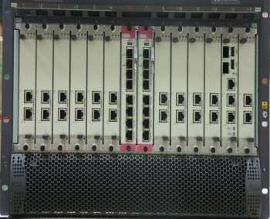


Self Service IVR
UAP
TTS
ASR
Resource layer
Control layer
IVR server
Open Interfaces – API, JTAPI, ActiveX
Drag and Drop GUI based development tools
TTS, ASR and Vxml support
Notes:
Explained in next slide

Slide 25
Self Service IVR
HUAWEI’s IVR solution design separates resource layer and the call control layer
Resources for IVR operations (Announcement playing, digit collection, voice recording, TTS, ASR, FAX etc. ) are provided by UAP
IVR Applications are executed at IVR Server

Slide 26
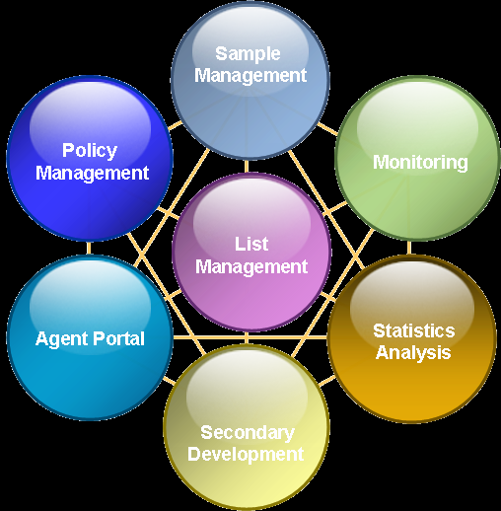
Outbound Service with Campaign Management
HUAWEI Outbound Service is a web based Campaign Management Application that supports three dialing modes.
Predictive Dialer Mode
Preview Dialer Mode
Progressive Dialer Mode
Notes:
Sample management: Sample of data can be tested against the campaign
Agent Portal: Agent application to take calls from campaign
Secondary Development: 3rd party integration with outbound system

Slide 27
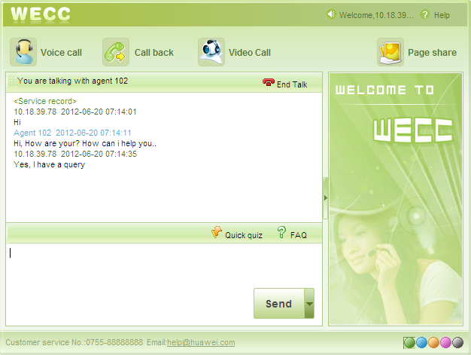
Web Enabled Contact Center
HUAWEI’s Web Enabled contact center (WECC) offers Web Voice call, Page Share, Call Back and Web Video call.
Notes:
WECC: WEB Enable Call Center supports Web Voice call, Page Share, Call Back and Web Video call. TopEng Call Center provide a Flash icon that can very easy to integrate WECC with a WEB Site.

Slide 28
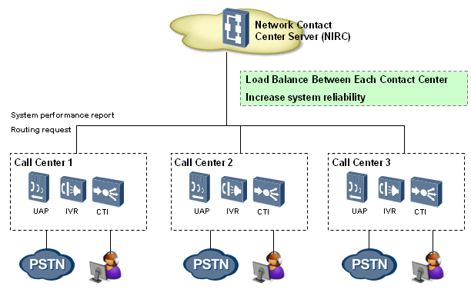
Network Call Center technology

Slide 29

Virtual Call Center technology
Independent Access Number
Independent Routing Strategy
Independent IVR Flow
Independent System Data
Independent Agent Group
Independent Configuration
Several Logical Call Centers
Independent real time report
Independent historical report
Virtual Contact Center Technology
For Multiple Services
Physical Platform
On demand IVR
On Demand Hosted CC
Outbound
CTI
IVR
Report
Monitor
ACD
QC
Customized Services
Notes:
This slide provides the overview of HUAWEI’s Hosted solution and the Virtual Contact Center Technology that enables HUAWEI IPCC to be most suitable for hosted services.
The On-Demand CC, Hosted CC or VCC means that call center operators establish a set of call centers, and on the basis of the call center, operators create VCCs for enterprises and allocate resources such as agent, automatic flow, and so on. In this case, enterprises only need to lease VCCs from operators and enjoy all services provided by the call center without affording the establishment cost.
Logically, VCCs are independent of each other, but they are created on the same call center and using one set of physical entity. Therefore, enterprises only need to pay the call center operator for certain service costs, without affording the establishment of the call center.
Each logical contact center has an independent management and independent resources. Independent resources mean the independent agent, call queue, service flow that each VCC has. Independent management means the independent configuration, monitoring and report statistics that each VCC has. Those features can fully meet the data security requirement of each enterprise.

Slide 30
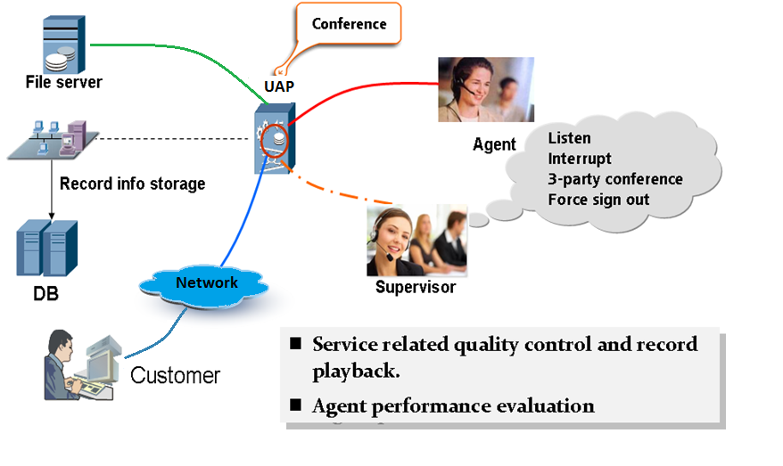
Recording Solution
Notes:
HUAWEI adopts the conference logging solution. we realize our recording solution via the board embedded in the ACD equipment.
Details and types of recording is mentioned in the next slide.

Slide 31
Recording Solution
HUAWEI has inbuilt recording function for voice logging and playback of recordings for monitoring and evaluation purposes
In Built Recording Options are:
Automatic Recording
All Calls are recorded
Percentage Recording
A specified percentage of calls are recorded.
Screen Recording
Screen recording can be done for individual agent screen
Supervisor Initiated Voice/Screen Recording
Calls that are selected for recording by the Supervisor or the Quality Analyst.
Notes:
Percentage Recording: only percentage of ongoing calls will be required if limited channels are there.

Slide 32
Unified Reporting
HUAWEI offers unified reporting platform as part of its IPCC solution.
The reporting platform can provide rich customized reports with a holistic view of technical and operational metrics of the contact center.
Advantages of Huawei Unified Reporting:
Professional and user friendly Web GUI
Easy customization of report templates
Scheduled report generation
Rapid deployment
Powerful Data Collection abilities
Notes:
Rapid Deployment: rapid customization of report

Slide 33
Open Interfaces for Integration
CRM
ERP
Billing
Etc.
Application
API
Agent Assisted
Integration
Self Service
Integration
JTAPI
CTI API
ActiveX
CCXML
Vxml
ActiveX
SCE/VXML
Voice
/Video
Log
CTI
IVR
API
API
CSTA
INtess
Soft ACD/MSP
Legend
Business Application development by ISV and System integrators
HUAWEI Call Center
3rd party systems

Slide 34
Implementation Scenarios
Requirement 1: A Bank wishes to set up a Call Centre with 120 IVR ports and 60 agents. Which UAP would be recommended in this scenario?
Solution: UAP 3300
Requirement 2: A Telecom company wants to setup a Network IVR with 10000 voice ports and 10000 video ports. Which UAP would be recommended here?
Solution: U2990
Requirement 3: An utility company desires to give an option to their customers to send an SMS to register a complaint. What would be ideal strategy for implementing this in IPCC?
Solution: The MSP component in IPCC can interface with a SMS Gateway and route SMS in form of an email request to the agents.

Slide 35
Implementation Scenarios…
Requirement 4: A prominent BPO services multiple clients. It needs to provide separate agents, reporting, monitoring and also ensure data integrity to each client. How can this can be achieved in IPCC?
Solution: Multi-Tenancy/Virtual Contact Centre can be established in IPCC by assigning logically separate VDNs to each client. Using this technology, one physical call center can provide up to 100 logical call centers. Each VCC has it’s own management module, report module, inspection module, agents, IVR etc. It would seem that each tenant has an own call center.
Requirement 5: A Telecom Contact Centre wants to integrate it’s IVR with a backend Billing system in order to play out the billing information to it’s customers. How can this be achieved in IPCC?
Solution: The IVR can achieve integration with a backend Billing system through the DTProxy middleware interface.

Slide 36
Implementation Scenarios…
Requirement 6: A Bank has 4 geographically distributed contact centers in a country, servicing each banking circle. The Bank wishes to achieve load balancing in order to increase the idle resource utilization. How can this be achieved in IPCC?
Solution: Network Center technology in IPCC can join distributed Contact Centers together to form a large-range unified Contact Centre. Calls can be transferred from one call center to another, together with data transfer. Network Call Center can make calls load balance and support shared resources.

Slide 37
USPs
All-in-one Box (UAP) - ACD, PBX, Voice Gateway, Media Resource (IVR) and Logger
Unique Architecture – Separation of Resource & Control (UAP – CTI)
Layered and Modular Design (Access Layer, Media Adaptation Layer, Service Layer)
License Based Control (Feature, Ports - Agent & Resource)

Slide 38
Glossary
IPCC – IPCC
PLMN – Public Land Mobile Network
PSTN – Public Switched Telephone Network
NGN – Next Generation Network
IMS– IP Multimedia System
CCS – Call/Core Control Server
IVR – Interactive Voice Response
SCE – Service Creation Environment
ASR – Automatic Speech Recognition
TTS – Text To Speech
MSP – Media Service Platform
UAP – Universal Access Platform
IRC – Intelligent Routing Center

Slide 39
Summary
During this course, we have gone through the following topics:
Overview of Huawei IPCC and its Core Components
Huawei IPCC Architecture
Introduction to UAP
Introduction to CTI
Huawei IPCC Highlights

Slide 40
Thank You
www.HUAWEI.com

